Slide 1
Searching, Paging, Validating and Event Handling

Slide 2
Hypermedia in a REST API
Hypermedia provides a common way to understand and self describe an API by providing metadata and allowable state transitions for the requested resource.
Self-documented and discoverable API!

Slide 3



Spring Data REST Hypermedia Components
HAL
Hypertext Application Language
ALPS
Application-Level Profile Semantics
JSON Schema
Schema definitions in JSON format

Slide 4


Validation with Spring Data REST
Constraints
Lifecycle Events
@NotNull @Min(10) @Max(100)
@Size(min=2, max=20)
…
BeforeCreateEvent
BeforeSaveEvent BeforeLinkSaveEvent BeforeDeleteEvent
AfterCreateEvent
AfterSaveEvent AfterLinkSaveEvent AfterDeleteEvent

Slide 5
Searching and Filtering with Spring Data REST
SpeakerJpaRepository
List<Speaker> findByFirstNameAndLastName(String firstName, String lastName); List<Speaker> findByFirstNameOrLastName(String firstName, String lastName);
HAL
"search": {
"href": "http://localhost:8080/api/speakers/search"
}
"findByFirstNameAndLastName": {
"href": "http://localhost:8080/api/speakers/search/findByFirstNameAndLastName{?firstName,lastName}", "templated": true
},
"findByFirstNameOrLastName": {
"href": "http://localhost:8080/api/speakers/search/findByFirstNameOrLastName{?firstName,lastName}", "templated": true
}

Slide 6
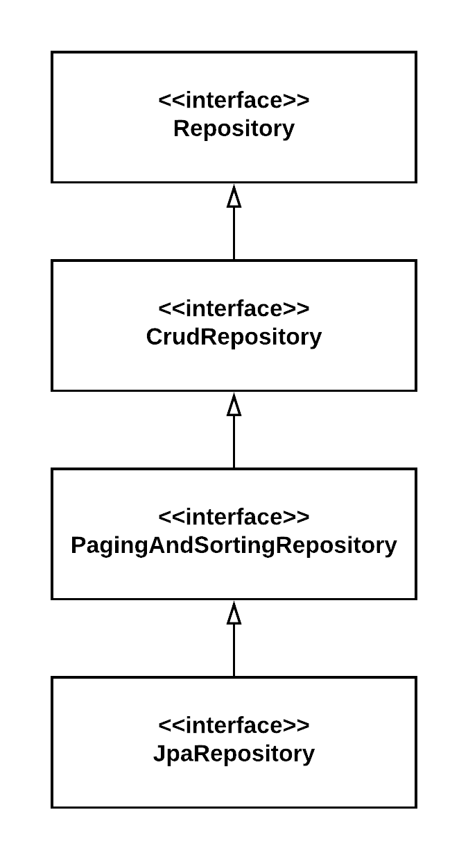

Paging and Sorting an API
findAll(Pageable pageable) findAll(Sort sort)
Page<Session> getSessionsWithName( @Param("name") String name, Pageable pageable
);
"getSessionsWithName": {
"href": "http://localhost:8080/api/conference_sessions/search/getSessionsWithName{
?name,page,size,sort,projection
}",
"templated": true
}

Slide 7

Summary
Hypermedia API validations API searching API paging

